Slide 1



Lot of In-built functions

Slide 2

Some of them are..
numpy.arange()
numpy.linespace()
numpy.ones()
In-Built
numpy.zeros()
numpy.full()
numpy.eye()
numpy.diag()
numpy.random.rand()
numpy.mean()
numpy.median()

Slide 3


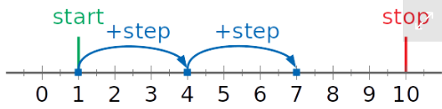
numpy.arange()
Syntax: numpy.arange([start, ]stop, [step, ], dtype=None)
start -The first value in the array.
stop- The number that defines the end of the array and isn’t included in the array.
step - The number that defines the difference between each two consecutive values in the array
and defaults to 1.
dtype - The type of the elements of the output array and defaults to None.
Result

Slide 4
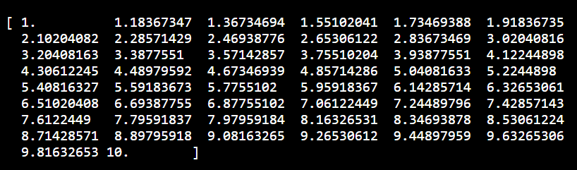


Numpy.linespace()
numpy.linspace() has two required parameters, start and stop, which you can use to set the
beginning and end of the range
Resultt
This code returns an ndarray with equally spaced intervals between the start and stop values.
This is a vector space, also called a linear space

Slide 5

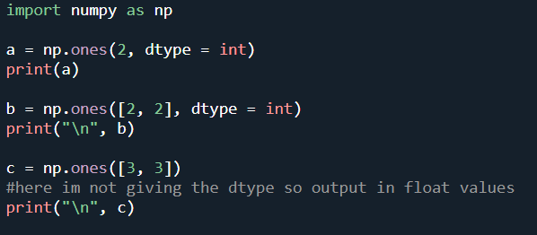
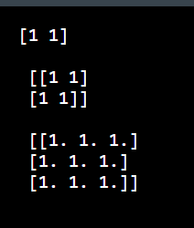
numpy.ones()
The numpy.ones() function returns a new array of given shape and type, with ones.
Syntax: numpy.ones(shape, dtype = None)
If you don't give dtype by default it will goive the float values.
Result

Slide 6
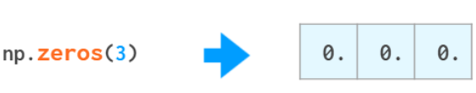
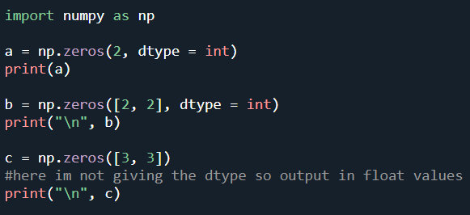
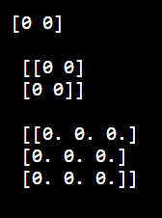
numpy.zeros()
Same as numpy.ones()but, numpy.zeros() function returns a new
array of given shape and type, with zeros
Syntax: numpy.zeros(shape, dtype = None)
Result

Slide 7

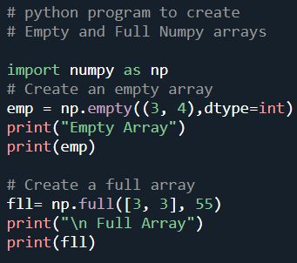
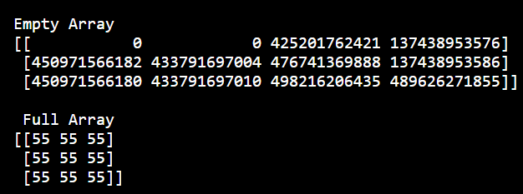
numpy.full() & numpy.empty()
we have two functions named as numpy.empty() and numpy.full() to create an empty and full arrays.
Syntax:
numpy.full(shape, fill_value, dtype = None)
numpy.empty(shape, dtype = None)
Result

Slide 8
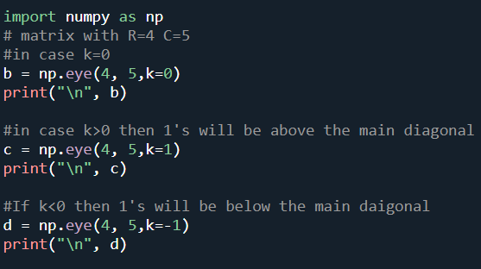
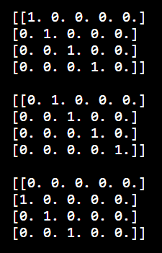

numpy.eye()
syntax : numpy.eye(R, C = None, k = 0, dtype = type <‘float’>)
R : Number of rows
C : [optional] Number of columns
k : [int, optional, 0 by default], Diagonal we require; k>0 means diagonal above main diagonal
or vice versa.
dtype: [optioanl] by default float
The eye tool returns a 2-D array with 1’s as the diagonal and 0’s elsewhere.
Result

Slide 9
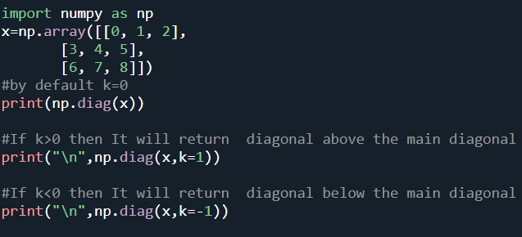


numpy.diag()
Syntax: numpy.diag(v, k=0)
It will extract a diagonal or construct a diagonal array.
Resultt

Slide 10



numpy.random.rand()
The numpy.random.rand() function creates an array of specified shape and fills it with
random values.
Syntax : numpy.random.rand(d0, d1, ..., dn)
d0, d1, ..., dn : [int, optional]Dimension of the returned array we require, If no argument is given a
single Python float is returned.
Result
Random Value

Slide 11
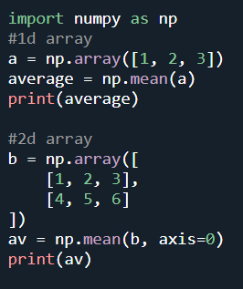
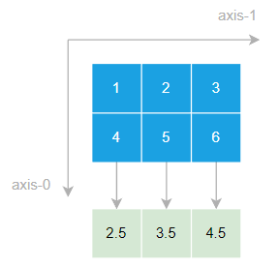

numpy.mean()
The numpy.mean () function returns the arithmetic average of a given NumPy array along the
specified axis.
Syntax:
numpy.mean(a, axis=None, dtype=None, out=None, keepdims=<no value>, *, where=<no value>)
a is an array that you want to calculate the average of elements.
axis is the axis if specified will return the average of elements on that axis.
Result

Slide 12

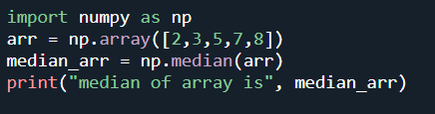

numpy.median()
numpy.median function is used to calculate the median of an array along a specific axis or multiple
axes. Median is defined as the middle value separating the higher half from the lower half of a data
sample in other words median is a value in the middle when you sort the values.
Syntax: numpy.median(arr, axis=None, out=None)
Result

Slide 13
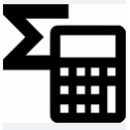



Mathematical Functions
Various mathematical operations.
Provides standard trigonometric functions
Handling complex numbers

Slide 14
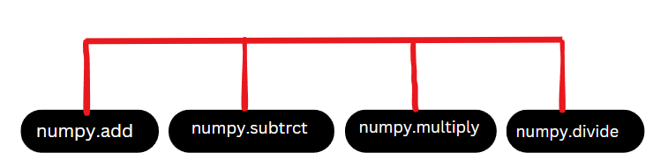

Mathematical operations in numpy

Slide 15

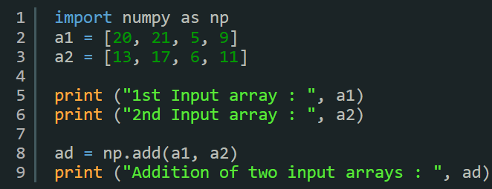
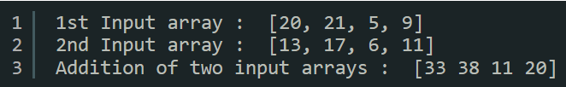
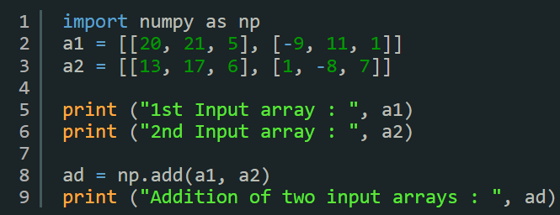
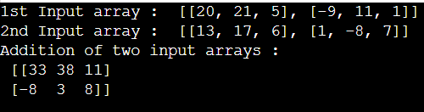
Examples on numpy.add()
Example for 1-D arrays:
Result:
Example for 2-D arrays:
Result:

Slide 16
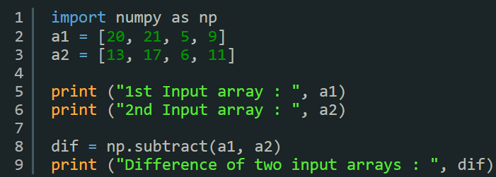


Examples on numpy.subtract()
Example for 1-D arrays:
Result:

Slide 17
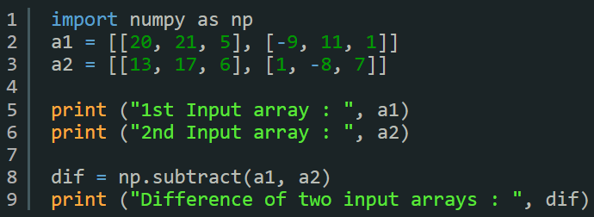

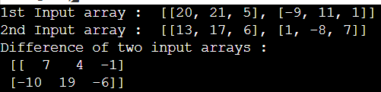
Examples on numpy.subtract()
Example for 2-D arrays:
Result:

Slide 18
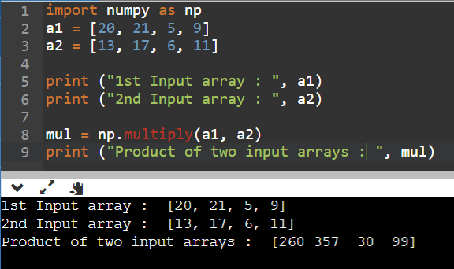

Examples on numpy.multiply()
Example for 1-D arrays:

Slide 19
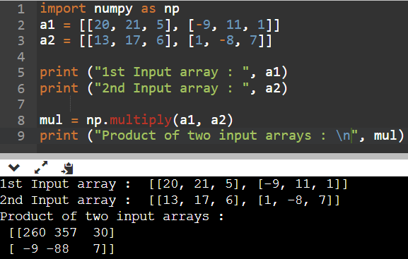

Examples on numpy.multiply()
Example for 2-D arrays:

Slide 20
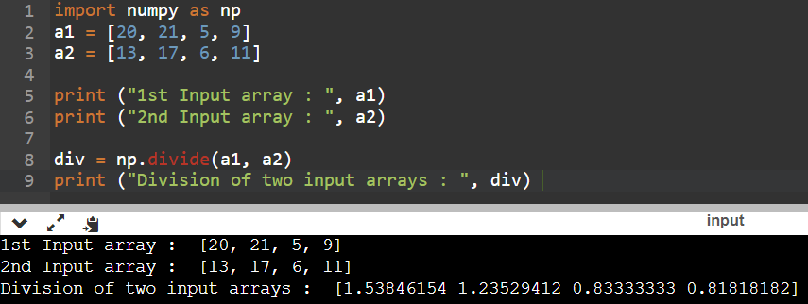

Examples on numpy.divide()
Example for 1-D arrays:

Slide 21
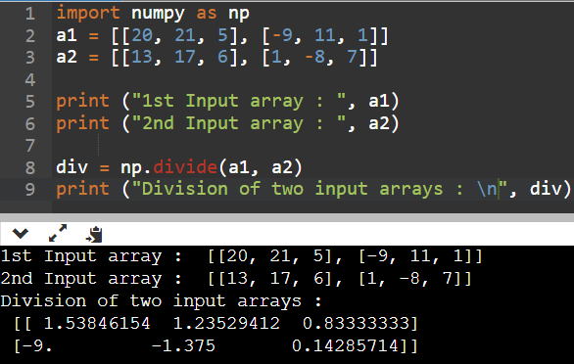

Examples on numpy.divide()
Example for 2-D arrays:

Slide 22

Trigonometric functions in numpy
A mathematical function
Used to calculate the trigonometric sine for all x, where x is an array.
Syntax:
numpy.sin(x[, out]) = ufunc ‘sin’)

Slide 23
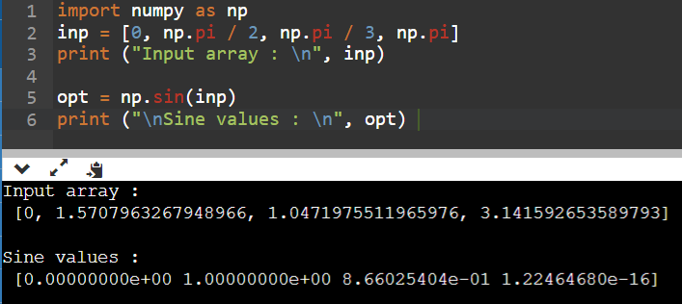

Examples on numpy.sin()
computes the trigonometric sine of a single number as
well as a Numpy array of angles.

Slide 24
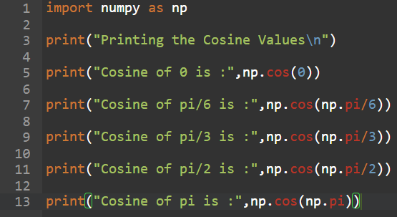
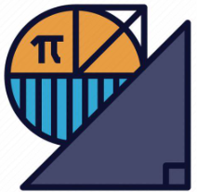
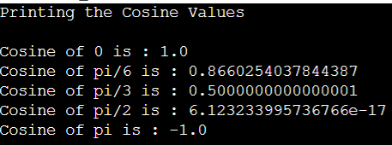
Examples on numpy.cos()
computes the trigonometric cosine of a single number as
well as a NumPy Array of angles.
Result:

